Slide 1
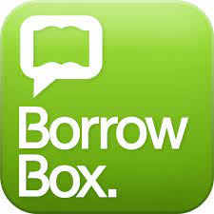
MUST HAVE APPS…
Get to know the Dewey Decimal Classification system
The best reasons to join your local library service…
All services provided by DLR , SDCC, DCC and Fingal Libraries
The entire Public Library, available in just two apps!

Slide 2
Step 1 – Join the Public Library
All Libraries have online registration available. Just check your local authority page for your own library area. This registration link is for Dun Laoghaire/ Rathdown :
https://dlr.spydus.ie/cgi-bin/spydus.exe/MSGTRN/WPAC/BRWREG
Write down your library barcode and keep it in a safe place!
<Name>
******
If you have a library card already, you don't need to get a new one to get access to eBooks & eAudiobooks. You just need to know your library card number and PIN. If you don’t have a PIN, click here https://librariesireland.freshdesk.com/support/solutions/articles/19000012731-how-do-i-login-to-my-library-account-
Notes:
To use any of the library online services you will need to join the library and get a library number and pin code. Click on the link and complete the form. If you are U18 you will need to have your parent/guardian complete the form with you. Once you hit submit you will received a temporary bar code which is your library number. When the library reopens you can drop in and you will received your usual library card.
If you have a library card for DLR already, you will need to get a PIN number. You can ring your local branch to get it set up for you or you can use this link if you have registered an email address with your account.

Slide 3
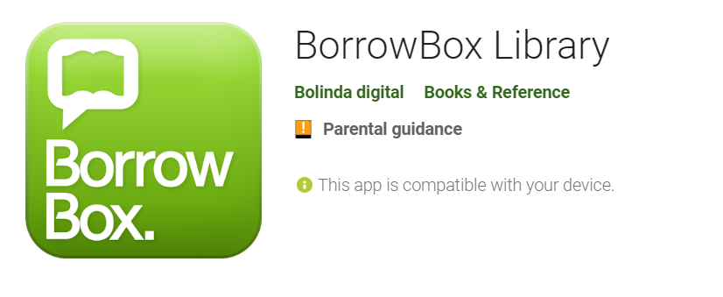
Download the Borrow Box or Libby App
Step 2
They both work in pretty much the same way, so these instructions for Borrowbox will work as well for Libby
Notes:
At this stage you now have your library number and your pin number. The next step is to download the BorrowBox app onto your device of choice. We already have it pre-loaded onto your iPad, but it will work on both Android and Apple devices AND you can install it on multiple devices. For example, I have it installed on my phone for listening to audiobooks and on my iPad for reading eBooks. Simples!

Slide 4
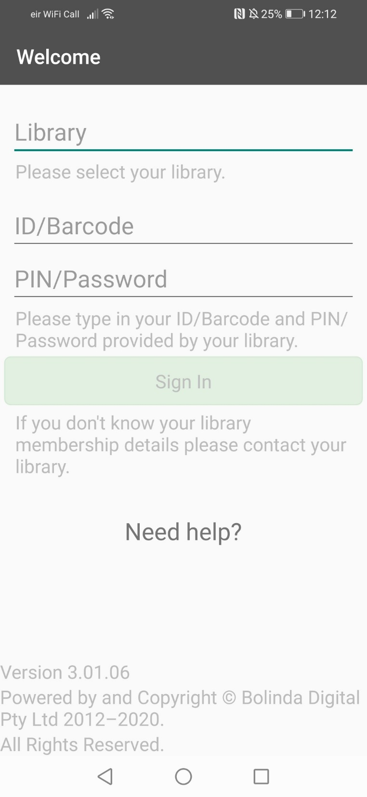
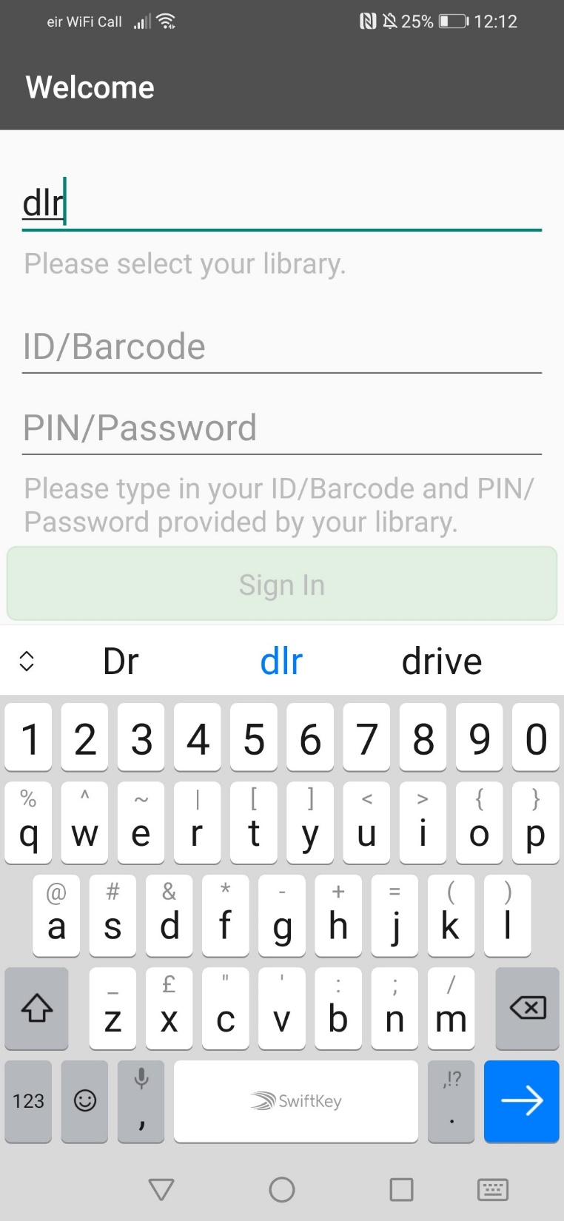
Step 3
Type in ‘Dlr’ and choose Dún Laoghaire-Rathdown Library
Type in your Library Number
Type in 4 digit PIN
Notes:
When you open the App you will need to select your own library service and enter your library number and PIN.
For example, if you are in the Dun Laoghaire Rathdown catchment, type in DLR and select Dun L R library.
Type in your library number and pin and sign in.
You are now ready to start borrowing.

Slide 5
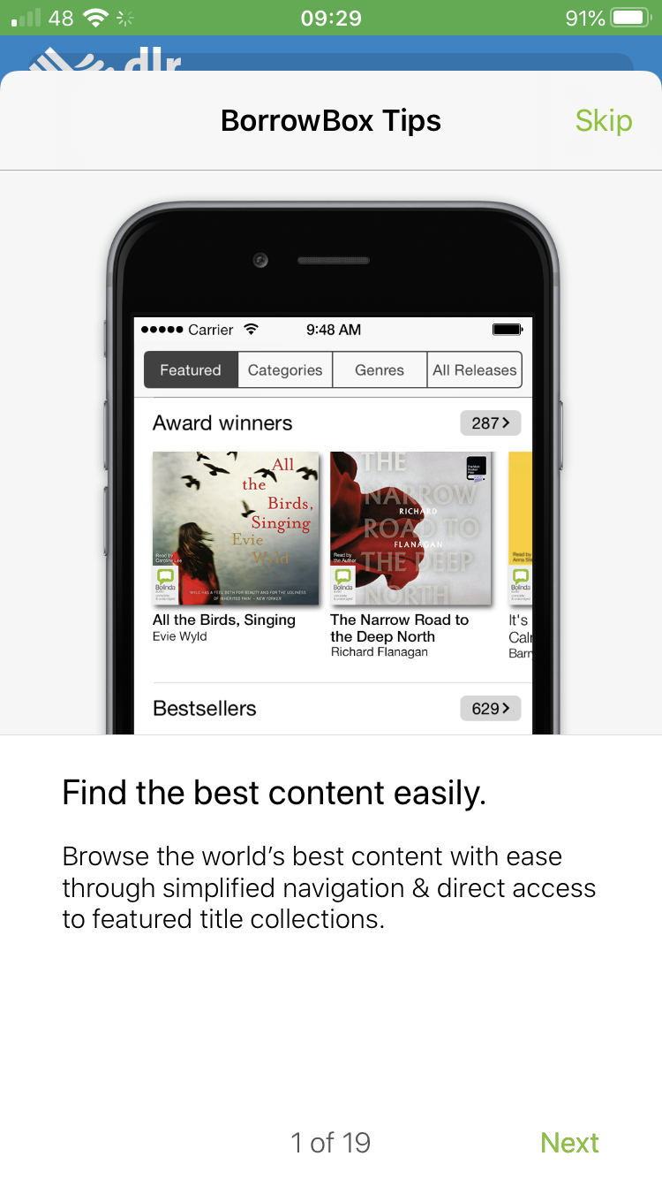
Step 4
Click through this tutorial for tips on how to use Borrowbox.
Notes:
First time users will be presented with a tutorial which is quite useful.
You are now fully ready to start borrowing.

Slide 6
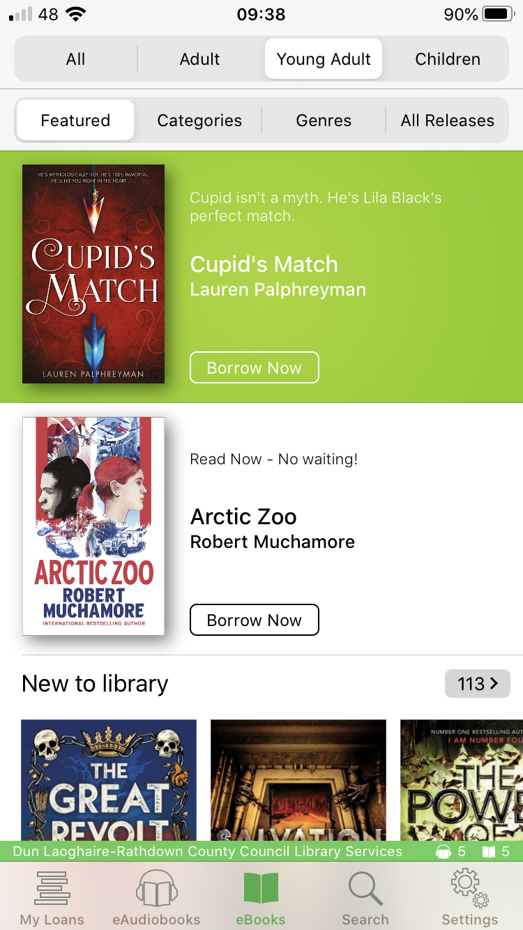
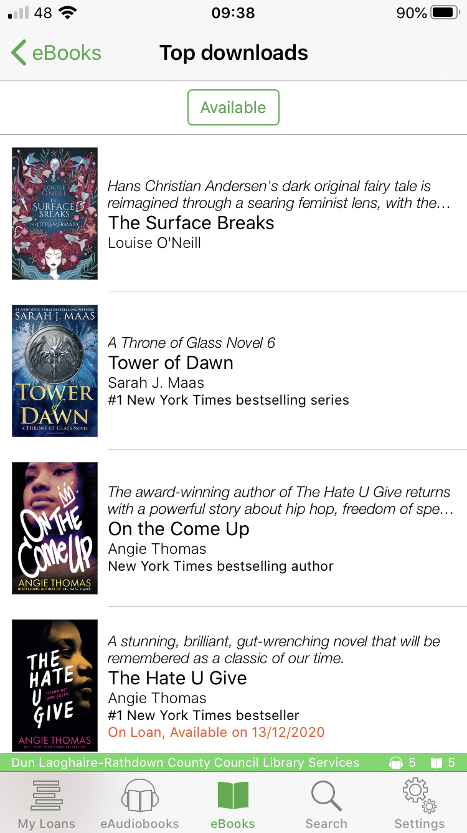
Step 5
Click on Young Adult to filter your search
Click Borrow and Download Now to Start Reading or Listening
Click on eBooks to browse eBooks
Notes:
BorrowBox has tons of titles so use the filters to only see those titles that interest you. For example, click on Young Adult to see books that are in that particular arena. Let’s have a look at borrowing an eBook.
Click on eBooks to browse.
You can see some featured lists such as top downloads.

Slide 7
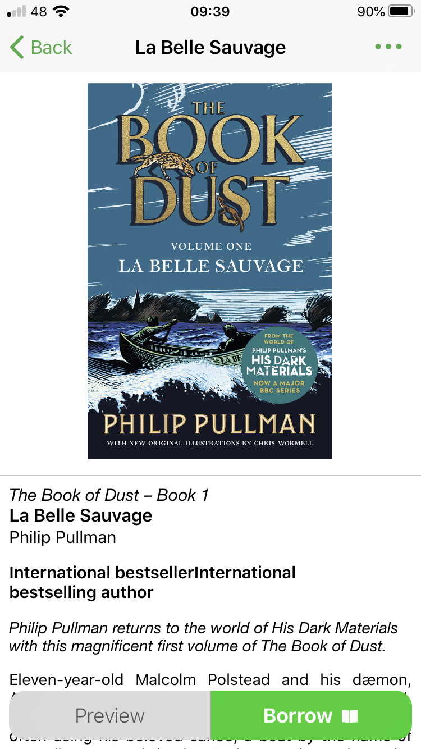
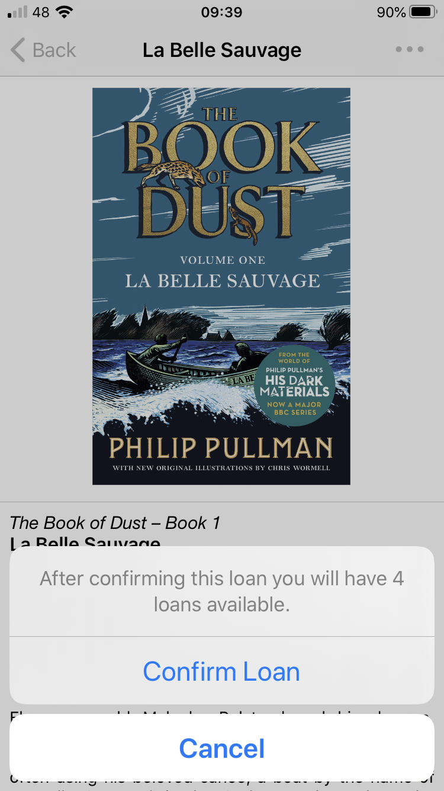
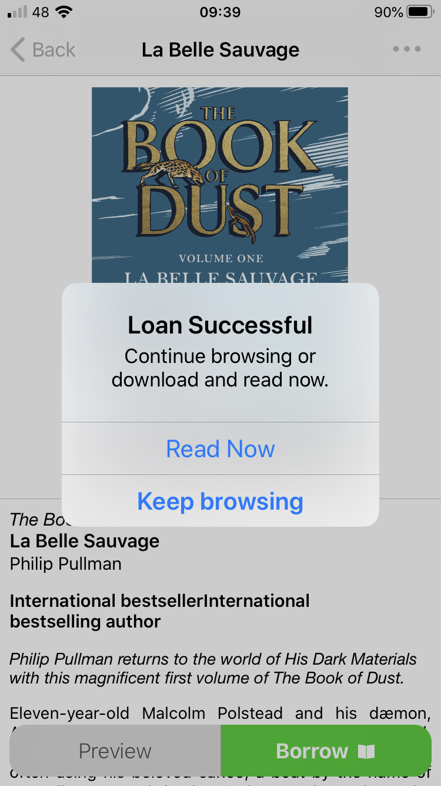
Step 6
Borrowing an eBook…
Click Borrow and Download Now to Start Reading or Listening
Notes:
Let’s borrow The Book of Dust. All you need to do is tap on the book to select it, click on Borrow and Click on Confirm Loan. You will see a confirmation message. You can choose to read immediately or continue to browse.
Let’s look at AudioBooks

Slide 8
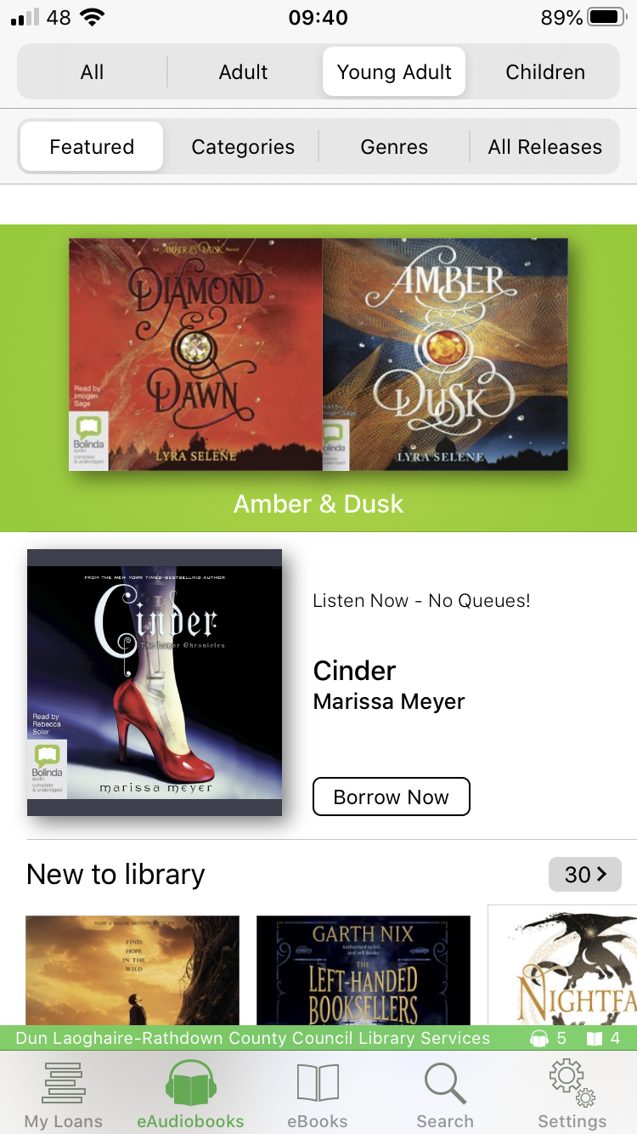
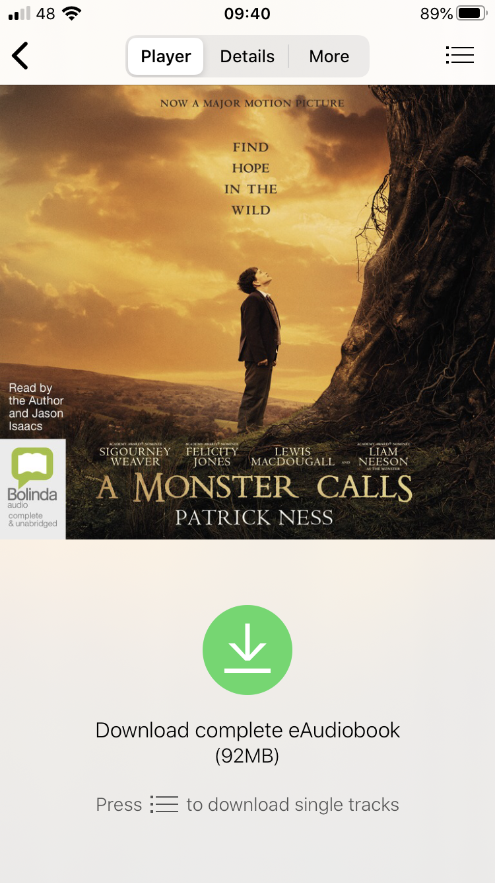
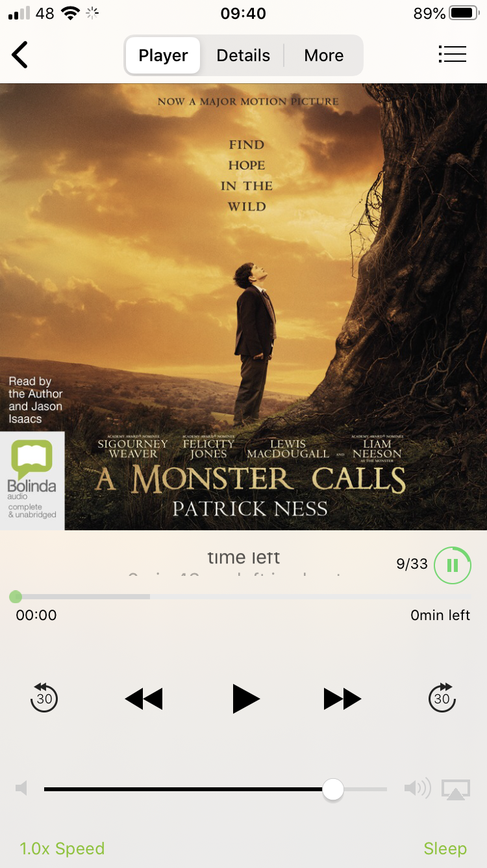
Step 7
Borrowing an eAudioBook…
Click Borrow and Download Now to Start Reading or Listening
Notes:
Let’s borrow A Monster Calls. All you need to do is tap on the book to select it, click on Borrow and Click on Confirm Loan. You will see a confirmation message and an option to download the complete audiobook. Don’t be worried about space as audiobooks are a collection of mp3 files that take up very little space.
You can use the control to play/pause, to go forward to the next track or to go back a track.

Slide 9
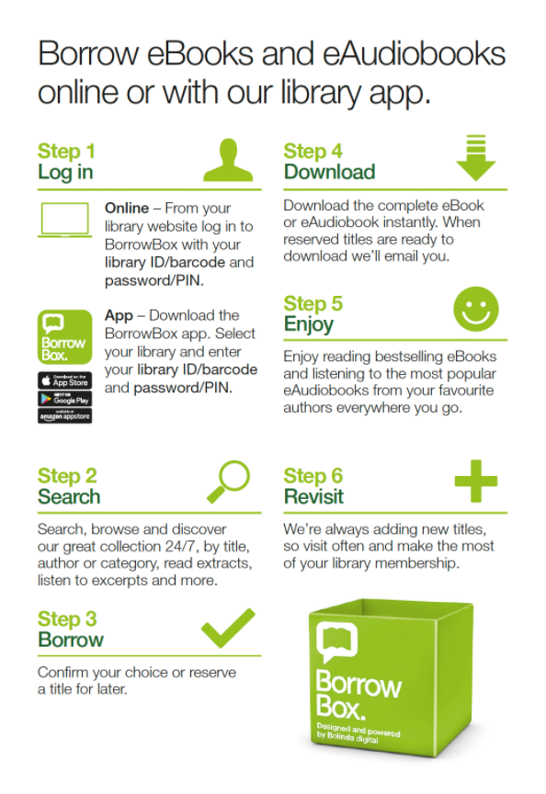
Step 8
Here is a quick overview of the steps.
Notes:
Here is a quick overview of the process. You can borrow up to 5 eBooks and 5 audiobooks at any one time. You can reserve a book if it’s unavailable and you will be notified to your email when it is available. You can renew a book if you need more time…..AND…..crucially….. There are no fines because the book will disappear from your device anyway at the end of the loan period which is 3 weeks! What a fantastic service ☺

Slide 10
Happy Reading!

